Slide 1
GSQL Query Writing Best Practices
Mar 6, 2023

Slide 2
Agenda
Part 1 - Thinking in GSQL
Part 2 - A Better Plan
Part 3 - Memory Optimization
Part 4 - Parallelization and Preprocessing
Part 5 - Data Structure Optimization

Slide 3
Graph Gurus 31
GSQL Writing Best Practices Part 1 - Thinking in GSQL
Notes:
Hello everyone and thank you for joining us today - we know that you are very busy - and appreciate you choosing to spend the next 45 minutes with us.
Today…
- we hope you will enjoy this presentation and find it informative.

Slide 4
Thinking in GSQL - Agenda
Review the Basics
The Thinking Steps
Example 1

Slide 5
The Basics

Slide 6
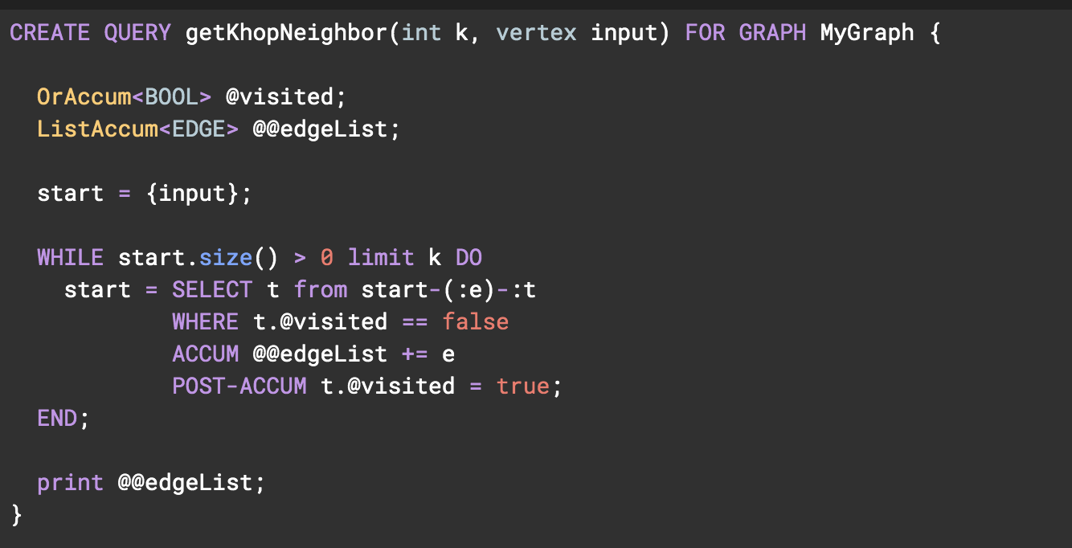
The Basics
Data Declare Session
Query Logic Session

Slide 7
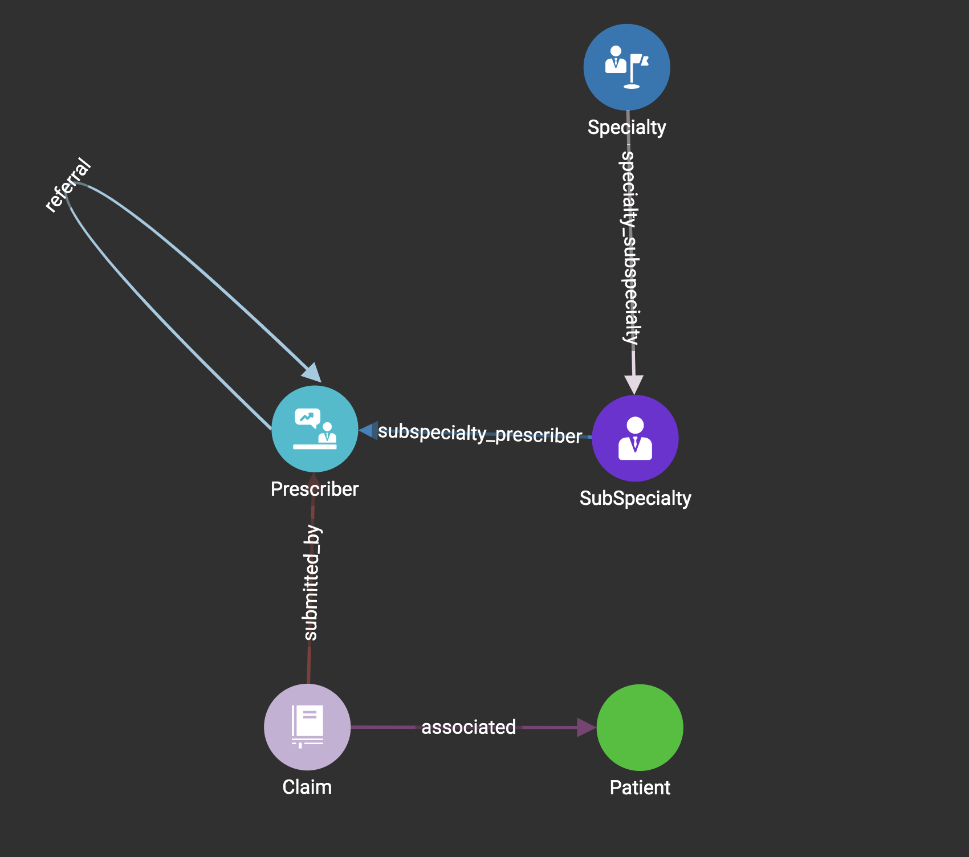
The Basics
GSQL traverses the graph from one set of vertices, through selected edges originated from the starting set, to another set of vertices:
cardiac electrophysiology,
cardiology
echocardiography
Cardiology

Slide 8
The Basics
Here start_set is the variable name of vertex set variable
A vertex set variable is where a SELECT statement starts from
A vertex set variable is also the outcome of a SELECT statement
In this case the vertex set start_set only contains one single vertex that is the input parameter
This is the recommended way to start your traversal logic
The query always starts with a seed vertex set - that is where your traversal logic originates from
Start from a single vertex:
CREATE QUERY example(VERTEX input_ver) FOR GRAPH g {
start_set = {input_ver};
….
}

Slide 9
The Basics
Start from a set of vertex:
CREATE QUERY example(SET<VERTEX> input_set) FOR GRAPH g {
start_set = input_set;
….
}
Start from a type of vertex, and all vertices:
CREATE QUERY example() FOR GRAPH g {
start_set = {Claim.*}; start_set2 = {ANY};
….
}

Slide 10
The Basics
Find all the claims of a patient
CREATE QUERY GetClaims(vertex<User> input_patient) FOR GRAPH Social { Start = {input_patient}; Claims = SELECT t FROM Start:s-(reverse_Associated:e)-Claim:t; PRINT Claims; }
Start is a vertex set initialized by the input vertex input_patient
FROM clause finds edges which match the pattern: source vertex is in Start, edge type is reverse_Associated, and target vertex is restricted to User type.
For each edge satisfies the conditions in the FROM clauses, s, e and t are aliases of source vertex, edge and target vertex.
s, e and t are not keywords, you can rename them.
Claims is a new vertex set equal to t.
Start
reverse_Associated
Claims
t
ClaimA
e
s
Input Patient
s
e
t
ClaimB
s
e
t
ClaiC
Notes:
[transition] Under the setup I just showed you, let’s perform a simple traversal.
In this example, we’re going to find all the friends of a specific person.
SELECT is the most fundamental block to building a query. It handles the traversal of the graph from one set of vertices to another. So in our case, we will perform 1 hop away from the source vertex to find all the user’s friends.
This is what it looks like in GSQL. The query name is GetFriends, and it accepts a vertex of the type user as input for our specific graph.
Start is a vertex set containing the vertex we first inputted when calling the query. vertex sets are like variables, they are a container of vertexes.
Friends is another vertex set containing the results of our 1-hop traversal. The results are stored in Friends by selecting t.
You may wonder what t is?
To answer that question. Let’s begin with FROM clause. FROM clause finds edges which match the pattern: source vertex is in Start, edge type is IsFriend, and target vertex is restricted to User type. For each edge satisfies the conditions in the FROM clauses, s, e and t are aliases of source vertex, edge and target vertex.
So here t is the alias of the target vertices, it means all the vertices on the right hand side.
In our case UserA UserB and UserC are the target vertexes denoted by alias t, that has been stored to vertex set Friends.
All aliases come after the colon symbol. Aliases can be renamed to whatever you want - they are not reserved keywords.
After the results are stored, we can print the vertex set of t that were selected in the traversal statement.
[Recap] So here, overall, this query traverse starting from a input vertex, finds all the friend user connected via edge IsFriends, store them in a vertex set, and print the vertex set in the end. Those are the most basic and essential elements of a SELECT block.

Slide 11
The Basics
FROM
resultSet = SELECT vSet
FROM ( edgeSet | vertexSet )
[whereClause] [accumClause]
[postAccumClause] [havingClause]
[orderClause] [limitClause] ;
FROM: select active vertices & edges.
WHERE: conditionally filter the active sets
ACCUM: iterate on edge set; compute with accumulators
POST-ACCUM: iterate on vertex sets; compute with accumulators
HAVING: conditionally filter the result set
ORDER BY: sort
LIMIT: max number of items
SELECT: result from source or target set
WHERE
ACCUM
POST-ACCUM
HAVING
ORDER BY
LIMIT
SELECT
Notes:
This is the basic structure of a query block - where you traverse the graph and store the results of accumulators and filters. The query begins with select - but select actually happens after traversal and going through the set filters.
All the phases are executed following a fixed order. Except FROM and SELECT all phases are optional. And each phase only executes once.

Slide 12
Accumulators
Accumulators are special type of variables that accumulate information about the graph during the traversal
Accumulating phase 1: receiving messages, the messages received will be temporarily put to a bucket that belongs to the accumulator
Accumulating phase 2: The accumulator will aggregate the messages it received based on its accumulator type - the aggregated value will become the accumulator’s value, and its value can be accessed
A
B
C
2,1,1
Accumulator
1
1
Value: 0
E
D
Value: 4
2
Graph
Notes:
There are two categories of Accumulators we can use in our queries - local accumulators and global accumulators. Local accumulators are declared using a single @ symbol, and global accumulators are declared with double @@ symbols.
Local accumulators store data about each vertex, and can only be accessed by the traversal instance. They are basically runtime attributes for each vertex. If you run into the vertex again in the same query block, you will be able to see and make decisions based on the attribute information.
Global accumulators store data about the entire graph and can be accessed by any node.

Slide 13

Accumulators
For example:
The teacher collects test papers from all students and calculates an average score.
Teacher: accumulator
Student: vertex/edge
Test paper: message sent to accumulator Average Score: final value of accumulator Phase 1: teacher collects all the test paper Phase 2: teacher grades it and calculate the average score.

Slide 14
Accumulators
Local Accumulators:
Each selected vertex has its own accumulator
Local means per vertex - each vertex does its own processing and considers what it can see/read/write
Global Accumulators:
Stored in stored globally, visible to all
All vertices and edges have access
e.x. SumAccum @A;
e.x. SumAccum @@B;
@A
2,1,1
1
@A
@A
4
1
1
4
@@B
1,4,10
15
@A
10
2
@A
Notes:
There are two categories of Accumulators we can use in our queries - local accumulators and global accumulators. Local accumulators are declared using a single @ symbol, and global accumulators are declared with double @@ symbols.
Local accumulators store data about each vertex, and can only be accessed by the traversal instance. They are basically runtime attributes for each vertex. If you run into the vertex again in the same query block, you will be able to see and make decisions based on the attribute information.
Global accumulators store data about the entire graph and can be accessed by any node.

Slide 15
Accumulators
The GSQL language provides many different accumulators, which follow the same rules for receiving and accessing data - each of them, however, has its unique way of aggregating values
1
3
5
1
3
5
1
3
5
1
3
5
1, 3, 5
1, 3, 5
1, 3, 5
1, 3, 5
Old Value:
2
New Value: 11
Old Value:
2
New Value: 5
Old Value:
2
New Value: 1
Old Value:
2
New Value: 2.75
SumAccum<int>
MaxAccum<int>
MinAccum<int>
AvgAccum
Computes and stores the cumulative sum of numeric values or the cumulative concatenation of text values.
The MaxAccum types calculate and store the cumulative maximum of a series of values.
The MinAccum types calculate and store the cumulative minimum of a series of values.
Calculates and stores the cumulative mean of a series of numeric values.
Notes:
There are many different types of accumulators. Their names are very intuitive so you can basically understand what they do just by reading the names.
SumAccum keeps a running total of integer values, or cumulative concatenation of text values.
Min/MaxAccum store the least/greatest value that has been passed into the accumulator, only accepting numerical values.
Avg Accum stores the running average of numerical values that have been passed in.

Slide 16
Accumulators
The GSQL language provides many different accumulators, which follow the same rules for receiving and accessing data - each of them, however, has its unique way of aggregating values.
(“userA”, 100)
1
3
3
5
1
3
3
5
1->2
1->3
5->2
(“userC”, 300)
userC,300
userA,100
1, 3, 3, 5
1, 5, 3, 3
1->2 1->3
5->2
Old Value:
[userD,150]
New Value:
[userC,300,
UserD,150,
userA,100]
Old Value:
[2]
New Value: [2,1,3,5]
Old Value:
[2]
New Value: [2,1,5,3,3]
Old Value:
[1->1]
New Value:
1->6 5->2
SetAccum<int>
ListAccum<int>
MapAccum<int,SumAccum<int>>
HeapAccum<Tuple>
Maintains a collection of unique elements.
Maintains a sequential collection of elements.
Maintains a collection of (key -> value) pairs.
Maintains a sorted collection of tuples and enforces a maximum number of tuples in the collection
Notes:
Set Accum maintains a set of unique elements - there cannot be any repeating elements stored.
List Accum accumulates a list of elements in the order of which it was received.
MapAccum stores data like a map, using key -> value pairs
HeapAccum maintains a sorted collection of tuples. (Like a max/min heap). You are able to define a capacity limit for this accumulator, and once the capacity is reached, the lowest will be dropped when another value is parsed.

Slide 17
The Thinking Steps

Slide 18
The Thinking Steps
Design a traversal plan Where to start from? What are the steps? What edge to use for each step?
Choose and define the accumulators What needs to be in the result? Where is the info needed? What accumulator to use?
Populate the accumulators How do we gather the info to the right place?
Print the result
Notes:
[transition] Under the setup I just showed you, let’s perform a simple traversal.
In this example, we’re going to find all the friends of a specific person.
SELECT is the most fundamental block to building a query. It handles the traversal of the graph from one set of vertices to another. So in our case, we will perform 1 hop away from the source vertex to find all the user’s friends.
This is what it looks like in GSQL. The query name is GetFriends, and it accepts a vertex of the type user as input for our specific graph.
Start is a vertex set containing the vertex we first inputted when calling the query. vertex sets are like variables, they are a container of vertexes.
Friends is another vertex set containing the results of our 1-hop traversal. The results are stored in Friends by selecting t.
You may wonder what t is?
To answer that question. Let’s begin with FROM clause. FROM clause finds edges which match the pattern: source vertex is in Start, edge type is IsFriend, and target vertex is restricted to User type. For each edge satisfies the conditions in the FROM clauses, s, e and t are aliases of source vertex, edge and target vertex.
So here t is the alias of the target vertices, it means all the vertices on the right hand side.
In our case UserA UserB and UserC are the target vertexes denoted by alias t, that has been stored to vertex set Friends.
All aliases come after the colon symbol. Aliases can be renamed to whatever you want - they are not reserved keywords.
After the results are stored, we can print the vertex set of t that were selected in the traversal statement.
[Recap] So here, overall, this query traverse starting from a input vertex, finds all the friend user connected via edge IsFriends, store them in a vertex set, and print the vertex set in the end. Those are the most basic and essential elements of a SELECT block.

Slide 19
Example
Order the specialties in descending order by the number of Claims

Slide 20
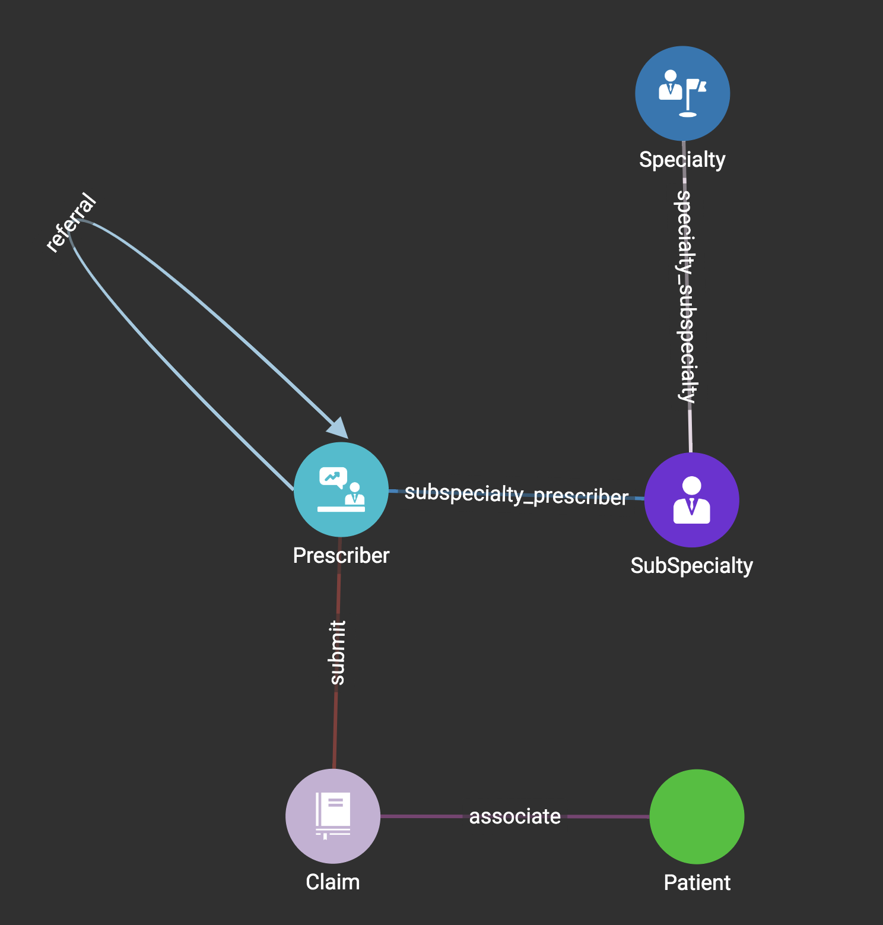
The Thinking Steps
Design a traversal plan Where to start from? Specialty? Claim? What are the steps? What edge to use for each step?
Claim -> Prescriber -> SubSpecialty -> Specialty
submit, subspecialty_prescriber, specialty_sub_specilaty
Notes:
[transition] Under the setup I just showed you, let’s perform a simple traversal.
In this example, we’re going to find all the friends of a specific person.
SELECT is the most fundamental block to building a query. It handles the traversal of the graph from one set of vertices to another. So in our case, we will perform 1 hop away from the source vertex to find all the user’s friends.
This is what it looks like in GSQL. The query name is GetFriends, and it accepts a vertex of the type user as input for our specific graph.
Start is a vertex set containing the vertex we first inputted when calling the query. vertex sets are like variables, they are a container of vertexes.
Friends is another vertex set containing the results of our 1-hop traversal. The results are stored in Friends by selecting t.
You may wonder what t is?
To answer that question. Let’s begin with FROM clause. FROM clause finds edges which match the pattern: source vertex is in Start, edge type is IsFriend, and target vertex is restricted to User type. For each edge satisfies the conditions in the FROM clauses, s, e and t are aliases of source vertex, edge and target vertex.
So here t is the alias of the target vertices, it means all the vertices on the right hand side.
In our case UserA UserB and UserC are the target vertexes denoted by alias t, that has been stored to vertex set Friends.
All aliases come after the colon symbol. Aliases can be renamed to whatever you want - they are not reserved keywords.
After the results are stored, we can print the vertex set of t that were selected in the traversal statement.
[Recap] So here, overall, this query traverse starting from a input vertex, finds all the friend user connected via edge IsFriends, store them in a vertex set, and print the vertex set in the end. Those are the most basic and essential elements of a SELECT block.

Slide 21
The Thinking Steps
2. Choose and define the accumulators What is the final result?
Where is the info needed for the final result? What accumulator to use?
Specialties order by number of the claims
We need to count the number of claims, so the info is on Claim vertexes
Number of claims is a integer summed value. So we are using SumAccum<INT>
Notes:
[transition] Under the setup I just showed you, let’s perform a simple traversal.
In this example, we’re going to find all the friends of a specific person.
SELECT is the most fundamental block to building a query. It handles the traversal of the graph from one set of vertices to another. So in our case, we will perform 1 hop away from the source vertex to find all the user’s friends.
This is what it looks like in GSQL. The query name is GetFriends, and it accepts a vertex of the type user as input for our specific graph.
Start is a vertex set containing the vertex we first inputted when calling the query. vertex sets are like variables, they are a container of vertexes.
Friends is another vertex set containing the results of our 1-hop traversal. The results are stored in Friends by selecting t.
You may wonder what t is?
To answer that question. Let’s begin with FROM clause. FROM clause finds edges which match the pattern: source vertex is in Start, edge type is IsFriend, and target vertex is restricted to User type. For each edge satisfies the conditions in the FROM clauses, s, e and t are aliases of source vertex, edge and target vertex.
So here t is the alias of the target vertices, it means all the vertices on the right hand side.
In our case UserA UserB and UserC are the target vertexes denoted by alias t, that has been stored to vertex set Friends.
All aliases come after the colon symbol. Aliases can be renamed to whatever you want - they are not reserved keywords.
After the results are stored, we can print the vertex set of t that were selected in the traversal statement.
[Recap] So here, overall, this query traverse starting from a input vertex, finds all the friend user connected via edge IsFriends, store them in a vertex set, and print the vertex set in the end. Those are the most basic and essential elements of a SELECT block.

Slide 22
The Thinking Steps
3. Populate the accumulators How do we gather the info to the right place?
Pass the number of claims from claims vertexes to specialty vertexes
Notes:
[transition] Under the setup I just showed you, let’s perform a simple traversal.
In this example, we’re going to find all the friends of a specific person.
SELECT is the most fundamental block to building a query. It handles the traversal of the graph from one set of vertices to another. So in our case, we will perform 1 hop away from the source vertex to find all the user’s friends.
This is what it looks like in GSQL. The query name is GetFriends, and it accepts a vertex of the type user as input for our specific graph.
Start is a vertex set containing the vertex we first inputted when calling the query. vertex sets are like variables, they are a container of vertexes.
Friends is another vertex set containing the results of our 1-hop traversal. The results are stored in Friends by selecting t.
You may wonder what t is?
To answer that question. Let’s begin with FROM clause. FROM clause finds edges which match the pattern: source vertex is in Start, edge type is IsFriend, and target vertex is restricted to User type. For each edge satisfies the conditions in the FROM clauses, s, e and t are aliases of source vertex, edge and target vertex.
So here t is the alias of the target vertices, it means all the vertices on the right hand side.
In our case UserA UserB and UserC are the target vertexes denoted by alias t, that has been stored to vertex set Friends.
All aliases come after the colon symbol. Aliases can be renamed to whatever you want - they are not reserved keywords.
After the results are stored, we can print the vertex set of t that were selected in the traversal statement.
[Recap] So here, overall, this query traverse starting from a input vertex, finds all the friend user connected via edge IsFriends, store them in a vertex set, and print the vertex set in the end. Those are the most basic and essential elements of a SELECT block.

Slide 23
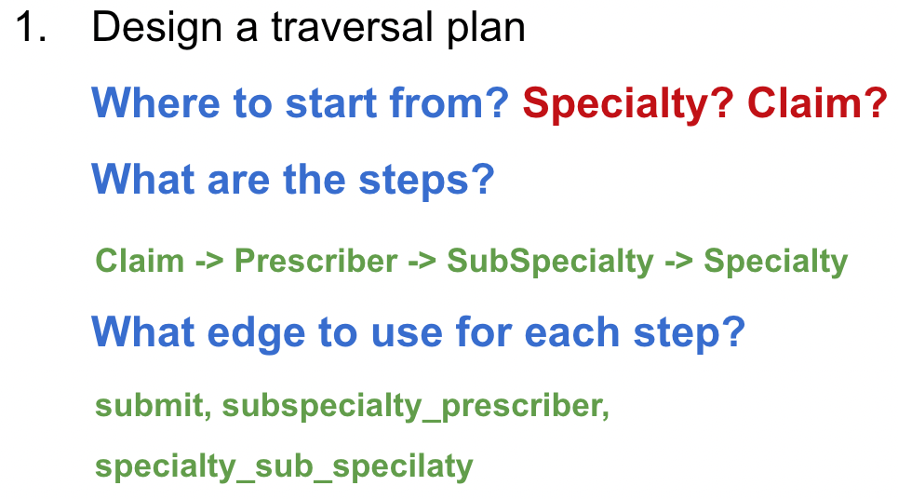
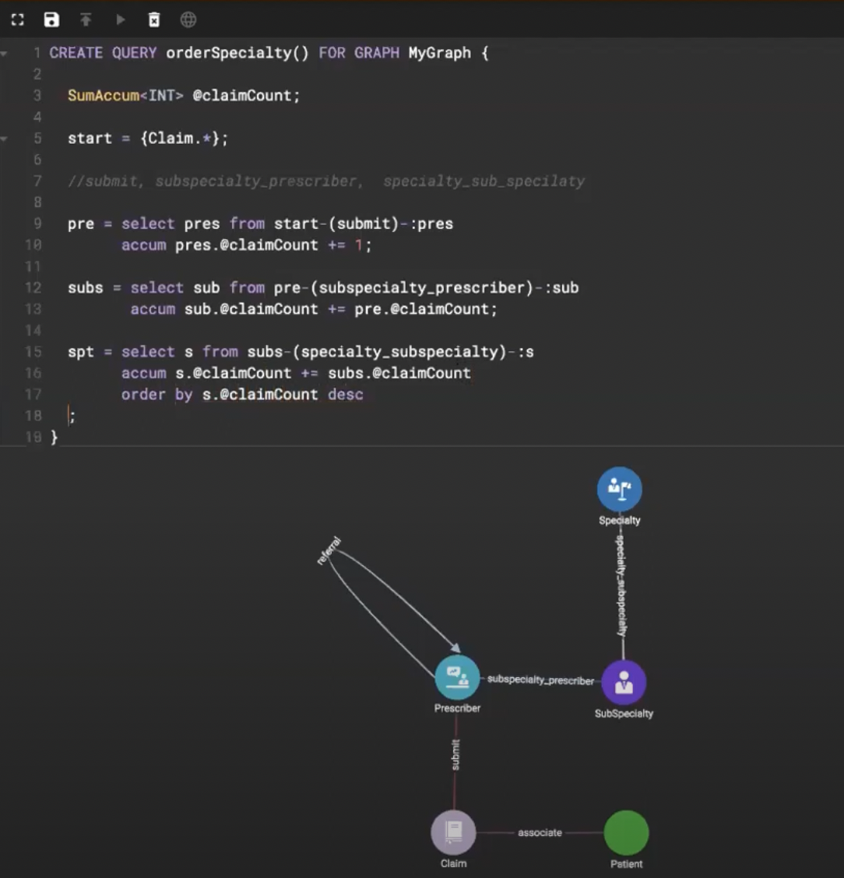
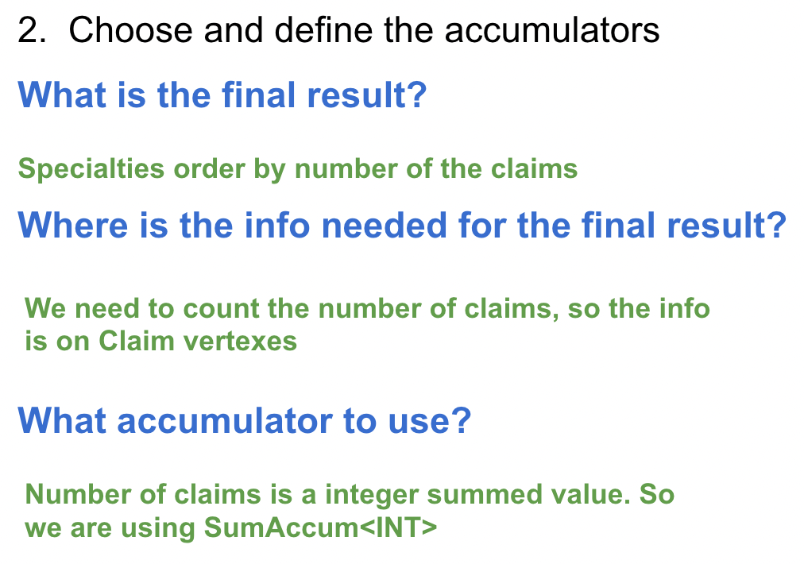
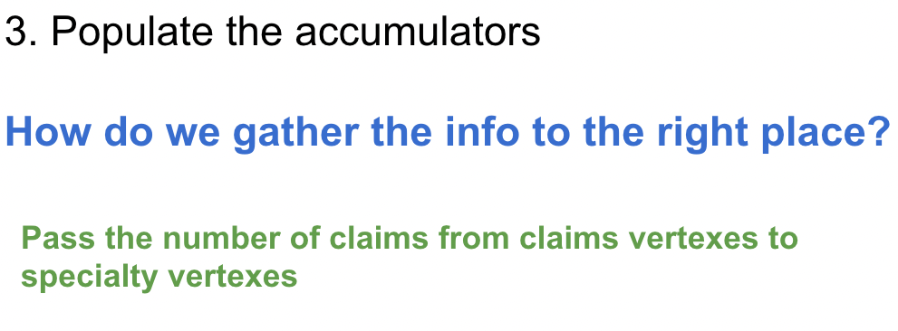
The Thinking Steps
Notes:
[transition] Under the setup I just showed you, let’s perform a simple traversal.
In this example, we’re going to find all the friends of a specific person.
SELECT is the most fundamental block to building a query. It handles the traversal of the graph from one set of vertices to another. So in our case, we will perform 1 hop away from the source vertex to find all the user’s friends.
This is what it looks like in GSQL. The query name is GetFriends, and it accepts a vertex of the type user as input for our specific graph.
Start is a vertex set containing the vertex we first inputted when calling the query. vertex sets are like variables, they are a container of vertexes.
Friends is another vertex set containing the results of our 1-hop traversal. The results are stored in Friends by selecting t.
You may wonder what t is?
To answer that question. Let’s begin with FROM clause. FROM clause finds edges which match the pattern: source vertex is in Start, edge type is IsFriend, and target vertex is restricted to User type. For each edge satisfies the conditions in the FROM clauses, s, e and t are aliases of source vertex, edge and target vertex.
So here t is the alias of the target vertices, it means all the vertices on the right hand side.
In our case UserA UserB and UserC are the target vertexes denoted by alias t, that has been stored to vertex set Friends.
All aliases come after the colon symbol. Aliases can be renamed to whatever you want - they are not reserved keywords.
After the results are stored, we can print the vertex set of t that were selected in the traversal statement.
[Recap] So here, overall, this query traverse starting from a input vertex, finds all the friend user connected via edge IsFriends, store them in a vertex set, and print the vertex set in the end. Those are the most basic and essential elements of a SELECT block.

Slide 24

Graph Gurus 33
GSQL Writing Best Practices Part 2 - A Better Plan
Notes:
Hello everyone and thank you for joining us today - we know that you are very busy - and appreciate you choosing to spend the next 45 minutes with us.
Today…
- we hope you will enjoy this presentation and find it informative.

Slide 25
Thinking in GSQL - Agenda
Review the Basics II
What is a Better Plan?
How to Check the Log

Slide 26
The Basics II

Slide 27
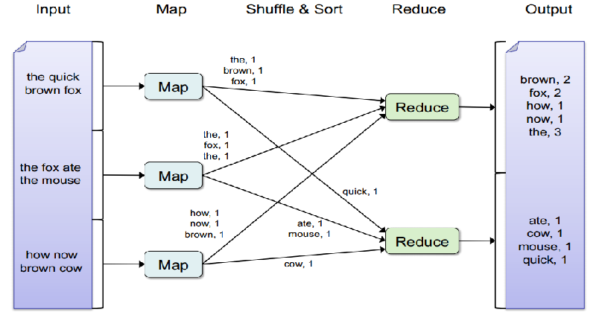
The Basics II
map-reduce

Slide 28
The Basics II
ACCUM runs on the edges(vertices if not edges referred).
POST-ACCUM runs on the vertexes after ACCUM.
Both ACCUM and POST-ACCUM are running logic of map
After execution of ACCUM and POST-ACCUM there is a hidden reduce phase is executed to aggregate the values.

Slide 29

Exampe Setup
In this tutorial the example will be given based on schema below. This is a social network of people who are connected as friends.
User
User
Vertex Attributes: Uint:age String: gender
IsFriend
Edge Attribute:
DateTime: ConnectDt
Notes:
[Transition]
This is the setup of our tutorial.
Let’s use this simple graph schema set up as our example. We have a social graph of users and when they became friends. Think of Facebook as an example. Each node represents a person or user of the platform, and the edge between them is the date they first connected. Each user node has two attributes - age and gender. And each edge contains the attribute when each pair of users became friends.

Slide 30


ACCUM Clause
CREATE QUERY GetFriends(vertex<User> inputUser) FOR GRAPH Social {
MapAccum<uint, SumAccum<uint>> @@ageMap; Start = {inputUser}; Friends = SELECT t FROM Start:s-(IsFriend:e)-:t
WHERE e.connectDt BETWEEN to_datetime(“2018-01-01”)
AND to_datetime(“2019-01-01”)
ACCUM @@ageMap += (t.age/10->1); PRINT @@ageMap;
}
WHERE
Select the matching edges
What is the age distribution of friends that were registered in 2018?
ACCUM
Local compute + send messages
AGGREGATE
Aggregate the messages to accumulator
Each edge satisfying the FROM & WHERE clauses performs the ACCUM clause statements.
ACCUM has access to s, e and t.
In ACCUM, vertices do not see each other's updates b/c updates aren't processed until the AGGREGATE step.
The AGGREGATE phase is done automatically after ACCUM. After that, the updated accumulator value can be accessed
+= means sending message to accumulator
Start
IsFriend
Friends
t
25
UserA
e
2018-05-11
(2->1) (2->1) (3->1)
s
(2->1)
Input User
UserB
s
e
2018-08-01
t
28
@@ageMap
(2->1)
s
e
2019-01-22
UserC
(2->2) (3->1)
t
35
s
e
2018-02-22
t
31
UserD
(3->1)
Notes:
The Accum clause logic is done on the edge of each traversal instance, allowing it access to the source vertex, edge, and target vertex. Accumulators that are updated in the ACCUM clause cannot be immediately accessed/seen until after the ACCUM clause.

Slide 31
ACCUM Clause
Given an input user. Output the average age of their common friends.
18,23,33
@avgAge
CREATE QUERY GetFriends(vertex<User> inputUser) FOR GRAPH Social {
AvgAccum @avgAge;
Start = {inputUser}; Friends1Hop = SELECT t FROM Start:s-(IsFriend:e)-:t;
Friends2Hop = SELECT t
FROM Friends1Hop:s-(IsFriend:e)-:t
ACCUM t.@avgAge += s.age; print Friends2Hop;
}
Start
Friends1Hop
Friends2Hop
24.67
UserA
UserE
age:18
Input User
UserB
23,33
age:23
UserF
@avgAge
28.00
UserC
age:33
UserD
UserG
age:46
46
@avgAge
46.00
Update of local accumulator cannot be seen during ACCUM phase
The messages will be aggregated during AGGREGATE phase based on accumulator type.
ACCUM
AGGREGATE
Send the messages to target nodes
Aggregate the messages to accumulator

Slide 32
POST-ACCUM
1, 2, 3
@@maxCNum
3
Given a set of persons (friends of friends of the inputUser), output the normalized number of common friends for each person in the set.
Start
Friends1Hop
Friends2Hop
1,1,1
@cNum
@normCNum
1 CREATE QUERY GetFriends(vertex<User> inputUser) FOR GRAPH Social {
2 SumAccum<uint> @cNum;
3 SumAccum<float> @normCNum;
4 MaxAccum<float> @@maxCNum;
5 Start = {inputUser}; 6 Friends1Hop = SELECT t FROM Start:s-(IsFriend:e)-:t;
7 Friends2Hop = SELECT t
8 FROM Friends1Hop:s-(IsFriend:e)-:t
9 ACCUM t.@cNum += 1
10 POST-ACCUM @@maxCNum += t.@cNum;
11 Friends2Hop = select s FROM Friends2Hop:s
12 POST-ACCUM
13 s.@normCNum = s.@cNum/@@maxCNum; 14 print Friends2Hop;
15 }
UserA
3
1.0
UserE
3/3
Input User
UserB
1,1
UserF
@cNum
@normCNum
2/3
0.66
2
UserC
UserG
1
UserD
@cNum
@normCNum
1
1/3
0.33
SELECT
ACCUM
AGGREGATE
POST-ACCUM
POST-ACCUM
SELECT
AGGREGATE
Notes:
POST-ACCUM logic is done on the target vertex, only allowing access to the target vertex.
Operations that should only occur once per vertex should be done in the POST-ACCUM clause.

Slide 33
A Better Traversal Plan
Design the lightest weight traversal path
Think twice before starting a query with all vertices (of a given type)
Make the algorithm bidirectional
Avoid hub nodes, do the moonwalk
Multiple search conditions

Slide 34
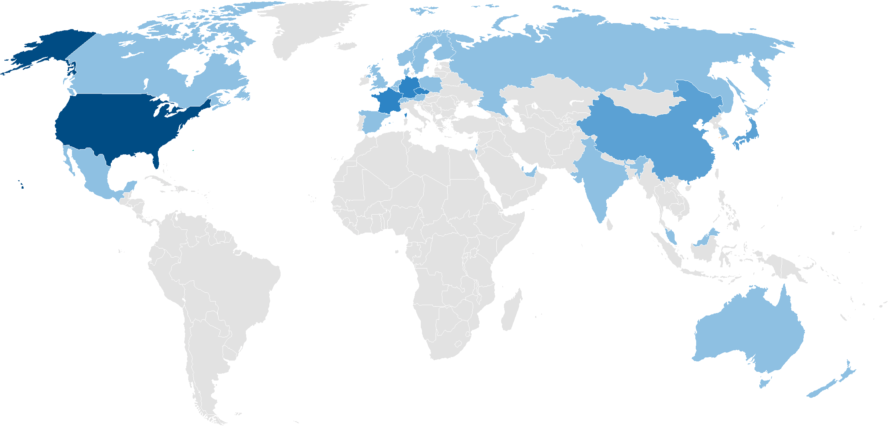

A Better Traversal Plan
1. Design the lightest weight traversal plan
Similar to relational DB query optimization, start with smaller sets, and prune your sets as early as possible.
Example: Find the US domiciled companies that have ultimate parent company in country Z. Z has fewer companies than the US.
By starting with the smaller set (Z instead of US), you can reduce the amount of computation.

Slide 35
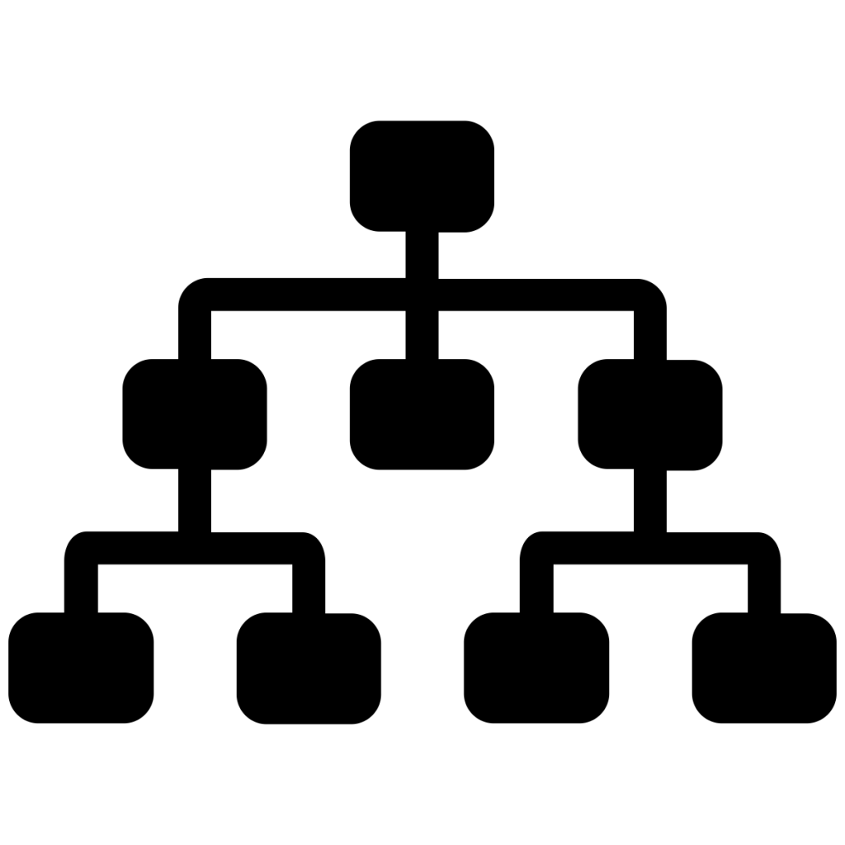
A Better Traversal Plan
1. Design the lightest weight traversal plan
Other Countries
Z
Other Countries
Other Countries
US
Other Countries
Levels of control relationship
Starting from US requires finding ultimate parent companies for all 40 million US companies.
The total number of edges traversed is in the 100s of millions
Levels of control relationship
Starting from Z, we only need to start with about 20K companies
The total number of edges traversed is below 1 million
……40 million US companies……
……20K companies……
US
Z

Slide 36
A Better Traversal Plan
CREATE QUERY q1 (vertex v) FOR GRAPH g1 {
Start = {company.*};
Start = SELECT s FROM Start:s
WHERE s == v;
...
}
2. Think twice before starting a query with all vertices (of a given type).
Start = {TYPEA.*}
Start = {ANY};
Is it possible to start from a small set of vertex IDs?
Only start from an entire vertex type when you have to.
CREATE QUERY q1 (vertex<company> v) FOR GRAPH g1 {
Start = {v};
...
}

Slide 37
A Better Traversal Plan
3. Start the traversal bidirectionally
When trying to find a path, it is much faster to do the traversal bidirectionally. For example: shortest path query and circle detection query.
Shortest Path
Target
Target
Start1
Start2
Source
Circle Detection
Source
Start
Unidirectional search
Bidirectional search
Why? Because the number of edges traversed is reduced exponentially.
Suppose each vertex has an average of 10 edges, and shortest path from Source to Target turns out to be 4 hops. With a unidirectional search, we will traverse 10*10*10*10 = 10,000 edges. With bidirectional search, we will traverse only 10*10 + 10*10 = 200 edges.

Slide 38
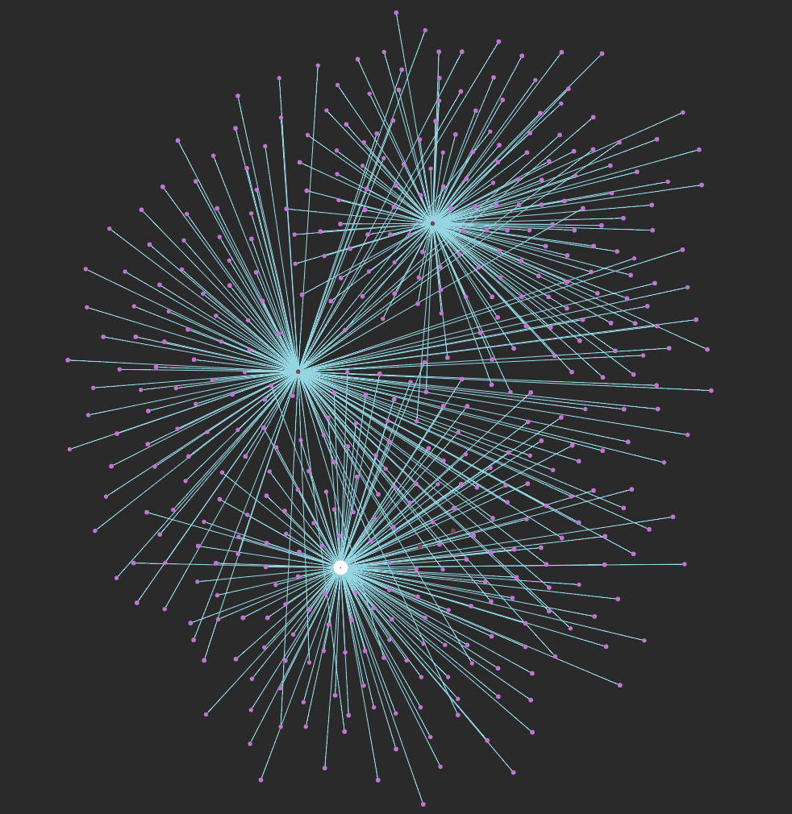
A Better Traversal Plan
4. Avoid hub nodes
Hub Nodes or Super Nodes are vertices having a huge number of neighbors. When traversal encounters such nodes it has to touch a very large portion of the graph, which hinders the query.
Design the traversal plan to avoid starting from the hub nodes.

Slide 39
A Better Traversal Plan
4. Avoid hub nodes
Example: Given a company A, find all companies that are in the same country and were ran by the same CEO
Jill
Companies: A,B,C,... CEOs: Todd, John, Bill...
Jill
H
H
A
A
H
G
H
G
John
John
B
B
US
Bill
US
Bill
C
C
Zach
7
D
Xu
D
Xu
F
E
F
E

Slide 40
A Better Traversal Plan
4. Avoid hub nodes
When there are multiple searching conditions. Start with the most special one.
Attr1
Vertex/EdgeType | Count
Attr1 | 10
Attr2 | 1,000,000
Attr3 | 10,000
Attr1_Company | 100,000,000
Attr2_Company | 100,000,000
Attr3_Company | 100,000,000
Company1
Attr2
Company2
Attr3

Slide 41
A Better Traversal Plan
4. Avoid hub nodes Alternatively, when an approximated result is good enough, you can also consider filtering the hub nodes out in your WHERE clause. Or use the SAMPLE clause to sample a subset of the neighbors.
WHERE t.outdegree() < 100000
SAMPLE 100 EDGE WHEN s.outdegree() > 1000000

Slide 42
A Better Traversal Plan
4. Avoid hub nodes Split the hub node at schema level.
day1
hub node
hub node
day2
day3
millions and millions

Slide 43
How to Check Query Log

Slide 44
Query Problems -- Log Checking
Query Execution Flow Chart
1.Nginx receives request
2.Nginx send request to Restpp
Query
Nginx
Restpp
3.Restpp send ID translation task to GSE, and query
request to GPE
4.GSE send translated ID to GPE, GPE starts to
process query
Incoming request
Returning
result
GPE
GSE
5.GPE send result to restpp, GPE send translation
task to GSE, GSE send translation result to Restpp
6.Restpp send result back to Nginx
7.Nginx send the response

Slide 45
Query Problems -- Log Checking
Nginx receives the request
>grep QUERY_NAME ~/tigergraph/logs/nginx/nginx_1.access.log
Nginx send request to Restpp
>grep QUERY_NAME /home/tigergraph/tigergraph/logs/RESTPP_1_1/log.INFO
Request ID
Note:
Here 1550790702138 is the request ID. With request ID all logs in Restpp, GPE and GSE can be found.

Slide 46
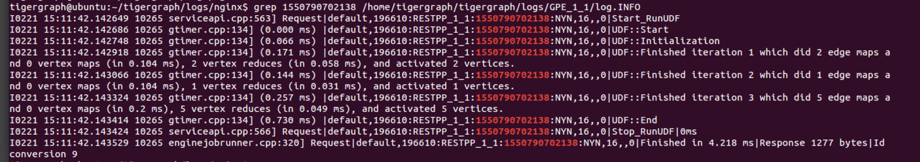
Query Problems -- Log Checking
GPE Process Query
GPE log is very important, most of time of a query is spent in GPE, GPE log gives you the detailed info of query
Execution. Such as data amount has been processed, time elapsed in each ACCUM and POST-ACCUM clause.
>grep REQUEST_ID /home/tigergraph/tigergraph/logs/GPE_1_1/log.INFO
Number of ACCUM clauses executed in each SELECT statement
Query Started
End of execution
Query execution time
Time spent in ACCUM clause
Number of POST-ACCUM clauses executed in each SELECT statement and its corresponding execution time
SELECT statements executed
Sent task to GSE and response to Restpp
# of vertices that has been selected to the vertex set

Slide 47
Query Problems -- Log Checking
GSE Process ID Translation Tasks
>grep REQUEST_ID /home/tigergraph/tigergraph/logs/GSE_1_1/log.INFO
Log above means GSE has receive the request from Restpp and has send the response to GPE
uid2vid request from Restpp
Note:
Here uid means external string ID, and vid means internal vertex ID.
Send response to GPE
vid2uid request from GPE
Send response to Restpp

Slide 48
Query Problems -- Log Checking
Restpp return the result to Nginx
>grep REQUEST_ID /home/tigergraph/tigergraph/logs/RESTPP_1_1/log.INFO
Return to Nginx
Nginx send out the response
>grep QUERY_NAME ~/tigergraph/logs/nginx/nginx_1.access.log

Slide 49
Graph Gurus 36
GSQL Writing Best Practices Part 3 - Memory Optimization
Notes:
Hello everyone and thank you for joining us today - we know that you are very busy - and appreciate you choosing to spend the next 45 minutes with us.
Today…
- we hope you will enjoy this presentation and find it informative.

Slide 50
Memory Optimization - Agenda
Memory Composition Of TigerGraph
How to check/monitor the memory usage.
What query semantics are memory consuming
Techniques to optimize memory usage.

Slide 51
Memory Composition Of TigerGraph

Slide 52
Memory Composition Of TigerGraph
TigerGraph Memory
Global Accumulators (Global Copy/Local Copy)
GPE
GSE(IDS)
Query 1
Query 2
MISC TG PROC
Query 3
...
Local Accumulators
Idle
Shuffled Partitions/Accumulators
Graph Partitions
Bidirectional ID Mapping
Current Activated Vertex Set
Upserted Vertices/Edges
Query Memory
Graph Updates
System Memory

Slide 53
How to check/monitor the memory usage.
From command line
From UI
From Logs
From RESTFUL API

Slide 54
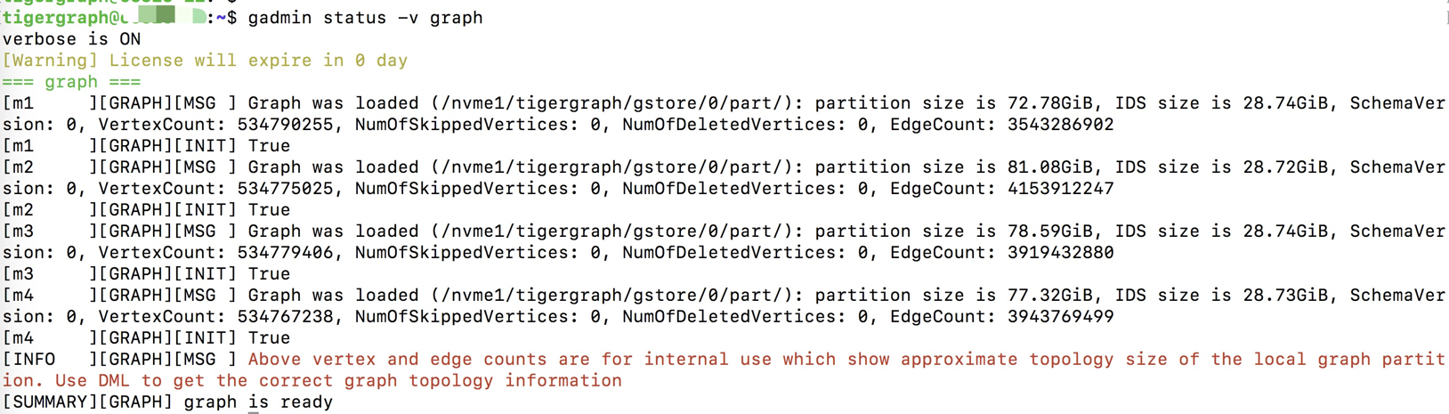
How to check/monitor the memory usage
From command line gadmin status -v graph

Slide 55
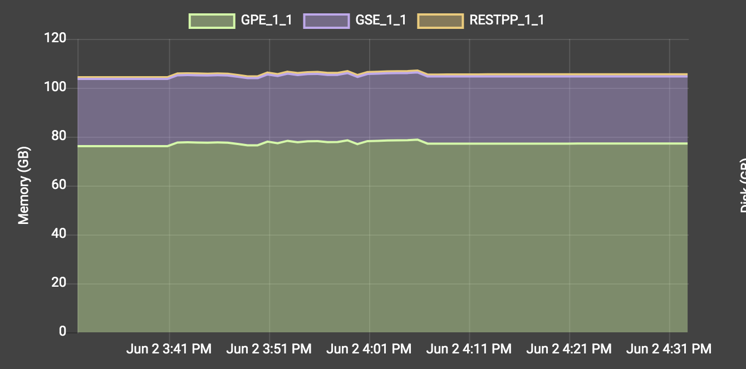
How to check/monitor the memory usage
Check from Admin Portal UI

Slide 56
How to check/monitor the memory usage
Check from LOG
In log.INFO of GPE
Default path: /home/tigergraph/tigergraph/log/gpe/GPE_1_1/log.INFO
Log example:
I0602 18:04:19.388418 70523 gsystem.cpp:490] System_GSystem|GSystemWatcher|Health|ProcMaxGB|0|ProcAlertGB|0|CurrentGB|78|SysMinFreePct|10|SysAlertFreePct|30|FreePct|87
CurrentGB|78: currently GPE consumes 78GB memory
SysMinFreePct|10: when system has less than 10% of free memory it starts to abort the queries
SysAlertFreePct|30: when system has less than 30% of free memory it slows down the graph update
FreePct|87: system has 87% of free memory

Slide 57
How to check/monitor the memory usage
Through RESTFUL API
curl "http://127.0.0.1:19000/api/datapoints?from=1593040083&to=1593044083&what=mem&who=GPE_1_1"
[{"detail":77320,"when":1591112511,"where":"m1","who":"GPE_1_1","what":"mem"},{"detail":77320,"when":1591112571,"where":"m1","who":"GPE_1_1","what":"mem"},{"detail":77320,"when":1591112631,"where":"m1","who":"GPE_1_1","what":"mem"},{"detail":77320,"when":1591112691,"where":"m1","who":"GPE_1_1","what":"mem"},{"detail":77320,"when":1591112751,"where":"m1","who":"GPE_1_1","what":"mem"},{"detail":77320,"when":1591112811,"where":"m1","who":"GPE_1_1","what":"mem"},{"detail":77320,"when":1591112871,"where":"m1","who":"GPE_1_1","what":"mem"},{"detail":77320,"when":1591112931,"where":"m1","who":"GPE_1_1","what":"mem"},{"detail":77320,"when":1591112991,"where":"m1","who":"GPE_1_1","what":"mem"},{"detail":77321,"when":1591113051,"where":"m1","who":"GPE_1_1","what":"mem"}.....]

Slide 58
What query semantics are memory consuming

Slide 59
What query semantics are memory consuming
Container type vertex-attached accumulators Vertex-attached accumulators are defined on every each vertex being traversed. If millions of vertices are traversed, then millions of container type accumulators will be defined in the memory. The memory consumption is larger when populating the accumulators, since extra memory is needed to performance parallel processing.
Large size container type global accumulators Global accumulators with large number of elements and complex structure are memory consuming too.
Using attribute/accumulator on target vertex
Container type accumulator include : SetAccum, BagAccum, SetAccum, ListAccu, MapAccum, HeapAccum, ArrayAccum, GroupByAccum

Slide 60
Techniques to optimize memory usage
Define light-weighted accumulators
Split the query load into batches
Query Calling Query
Clear up used containers

Slide 61
Techniques to optimize memory usage
1. Define Light-Weighted Accumulators
Calculate the sum of path weights to fraudulent account
CREATE QUERY getPaths (vertex<Account> input, int k) FOR GRAPH exampleGraph {
ListAccum<ListAccum<String>> @paths;
SetAccum<VERTEX> @@result_set;
Start (ANY) = {input};
Start = select s from Start:s post-accum s.@paths += [s.type];
WHILE Start.size() > 0 limit k DO
Start = select t from Start:s-()-:t
WHERE t.@paths.size() != 0
ACCUM t.@paths += s.@paths
POST-ACCUM t.@paths = t.@paths * [[t.type]],
CASE WHEN t.isFraud == true then
@@result_set += t
END;
END;
result = @@result_set;
print result;
}

Slide 62
Techniques to optimize memory usage
1. Define Light-Weighted Accumulators
Calculate the sum of path weights to fraudulent account
CREATE QUERY getPaths (vertex<Account> input, int k) FOR GRAPH exampleGraph {
SumAccum<float> @score, @@result;
Start (ANY) = {input};
WHILE Start.size() > 0 limit k DO
Start = select t from Start:s-()-:t
WHERE t.@score != 0 and t != input
ACCUM t.@score += s.@score
POST-ACCUM
CASE WHEN t.type == "typeA" then
s.@score * 0.5
WHEN...
END,
CASE WHEN t.isFraud == true then
@@result += s.@score
END;
END;
print @@result;
}

Slide 63
Techniques to optimize memory usage
2. Split the query load into batches
When is this needed?
The query involves all or a significant fraction of all vertices.
Each hop accumulators a significant amount of data in every local accumulator or in global accumulator(s).
The memory usage issue can be mitigated by splitting the query into batches.

Slide 64
Techniques to optimize memory usage
2. Split the query load into batches
Foreach company, find majority type of the subsidiaries.
// split the calculation into k batches
CREATE QUERY split (int k) FOR GRAPH exampleGraph { MapAccum<string,int> @map;
SumAccum<string> @majorityType; // define local and global accumulators
comps = {Company.*};
FOREACH i IN range [0, k-1] DO
tmp = SELECT s FROM comps:s
WHERE getvid(s) % k == i;
tmp = select s from tmp:s-(subsidiary:e)-:t
accum s.@map += (t.comp_type, 1)
Post-accum foreach (k,v) in s.@map do
…
End,
s.@map.clear() ...
END;
}
k is the number of batches that the job will be split into
Splitting the query into batches increases the execution time, but decreases peak memory usage.

Slide 65
Techniques to optimize memory usage
3. Query Calling Query
When is this needed?
Starting from a large amount of vertices
Result for each starting vertex needs to be collected from a subgraph in more than 1 hops.
Breaking a query into subqueries usually results in simpler data structures.
Only a limited amount of subqueries run in parallel
Memory is recycled after a subquery is done.

Slide 66
Techniques to optimize memory usage
3. Query Calling Query
E.g. In a enterprise graph, find companies having more than n bankrupt subsidiaries within k hops.
CREATE QUERY bankruptSub (int n, int k) FOR GRAPH exampleGraph {
SetAccum<vertex> @bankruptSet, @@result;
Start = {Enterprise.*};
Start = SELECT s FROM Start:s WHERE s.bankrupt == true ACCUM s.@bankruptSet += s;
WHILE Start.size() > 0 LIMIT k DO
Start = SELECT t FROM Start:s-(ControlledBy)->:t
ACCUM t.@bankruptSet += s.@bankruptSet,
t.@bankruptSet += t
POST-ACCUM
CASE WHEN t.@bankruptSet.size() > n THEN
@@result += t
END;
END;
PRINT @@result;
}

Slide 67
Techniques to optimize memory usage
3. Query Calling Query
CREATE QUERY subQuery (vertex v, int n, int k) FOR GRAPH exampleGraph RETURNS (BOOL){
SumAccum @@cnt;
Start = {v};
WHILE Start.size() > 0 AND @@cnt <= n LIMIT k DO
Start = SELECT t FROM Start:s-(Controls)->:t
POST-ACCUM
CASE WHEN t.bankrupt == true THEN
@@cnt += 1
END;
END;
CASE WHEN @@cnt >= n THEN RETURN true ELSE RETURN false END;
}
CREATE QUERY bankruptSub (int n, int k) FOR GRAPH exampleGraph {
SetAccum<vertex> @@result;
Start = {Enterprise.*};
Start = SELECT s FROM Start:s CASE WHEN subQuery(s,n,k) THEN @@result += s END;
}
When there are a huge amount of subqueries called, calling subquery might be slower. It depends on the # of hops traversed. However with limited memory it is a better choice.

Slide 68
Techniques to optimize memory usage
4. Clear Up Used Container
When is this needed?
The query uses vertex-attached container type accumulators.
The query traverses multiple hops and doesn’t revisit vertices.
Us the clear() function to empty container type accumulators releases memory.

Slide 69
Graph Gurus 38
GSQL Writing Best Practices Part 4 - Parallelization and Preprocessing
Notes:
Hello everyone and thank you for joining us today - we know that you are very busy - and appreciate you choosing to spend the next 45 minutes with us.
Today…
- we hope you will enjoy this presentation and find it informative.

Slide 70
Memory Optimization - Agenda
Query Execution Flow
Distributed Native Graph Storage
MPP mechanism of TigerGraph.
Best practices to make the query more parallel.
How to do preprocessing.

Slide 71
Query Execution Flow

Slide 72
Query Execution Flow
External
Vertex ID
GSE(IDS)
Query Name, parameters, vertexes
Request
Nginx
Restpp
Translated
Internal Vertex ID
Query Name, Parameters
GPE
Process Query Logic….
Translated External
VertexID
GSE(IDS)
Query Result
Combined Response
Request
Nginx
Restpp
Internal Vertex ID
In Response
JSON Response
Incoming
GPE
Outgoing
Notes:
dispatcher is an internal module to schedule and dispatch the tasks of a query (or an update) , e.g., which GPE as the master to process the query.
dispatcher is not a process itself. It's run inside RestPP server, restpp_loader, and GPE processes.

Slide 73
Distributed Native Graph Storage

Slide 74
Distributed Native Graph Storage
“USER123” <---> 1234321
IDS: Bidirectional external ID to Internal ID mapping
1234321, John, 33, john@abc.com 1234322, Tom, 27, tom@abc.com
...
Vertex Partitions: Vertex internal ID and attributes
1234321, 1234322, 2020-04-23, 3.3 1234321, 1234324, 2020-02-13, 2.3 ...
Edge Partitions: Source vertex internal ID target vertex internal ID, edge attributes
Notes:
dispatcher is an internal module to schedule and dispatch the tasks of a query (or an update) , e.g., which GPE as the master to process the query.
dispatcher is not a process itself. It's run inside RestPP server, restpp_loader, and GPE processes.

Slide 75
Distributed Native Graph Storage
Data of different components are split into segments.
IDS
1392273
VERTEX
EDGE
1
2
3
7
8
9
13
14
15
The segments are stored distributedly across the cluster.
4
5
6
10
11
12
16
17
18
1
2
3
7
8
9
13
14
15
The segments of different components with same ID stores data for the same set of vertices under the same vertex type.
4
5
6
10
11
12
16
17
18
1
2
3
7
8
9
13
14
15
The location of a vertex can be calculated based on its internal ID
4
5
6
10
11
12
16
17
18
Server 1
Server 2
Server 3

Slide 76
MPP mechanism of TigerGraph

Slide 77

MPP mechanism of TigerGraph
IDS
VERTEX
Processing Vertex-Induced ACCUM/WHERE clause
or POST-ACCUM/HAVING clause
EDGE
user_set = {User.*};
user_set = SELECT s FROM user_set:s
POST-ACCUM
…. // some logic;
1
2
3
4
5
6
7
8
9
10
1
2
3
4
5
6
7
8
9
10
A thread will be assigned to each vertex segment to perform the logic defined in the POST-ACCUM clause in parallel.
Once the task of one segment is done, the thread move to next unprocessed segment.
By default, the maximum # of CPU cores of a thread will be assigned.
CPU
1
2
3
4
5
6
7
8
9
10
Server

Slide 78
MPP mechanism of TigerGraph
IDS
VERTEX
Processing Edge-Induced WHERE/ACCUM clause
EDGE
user_set = {User.*};
user_set = SELECT s FROM user_set:s-(:e)->:t
ACCUM
…. // some logic;
1
2
3
4
5
6
7
8
9
10
1
2
3
4
5
6
7
8
9
10
A thread will be assigned to each edge segment to perform the logic defined in ACCUM clause in parallel.
Once the task of a segment is done, the thread move to next unprocessed segment.
By default, the maximum # of CPU cores of a thread will be assigned
CPU
1
2
3
4
5
6
7
8
9
10
Server

Slide 79
MPP mechanism of TigerGraph
IDS
VERTEX
Processing Edge-Induced WHERE/ACCUM clause distributedly
EDGE
1
2
3
4
5
11
12
13
14
15
6
7
8
9
10
16
17
18
19
20
1
2
3
4
5
11
12
13
14
15
6
7
8
9
10
16
17
18
19
20
CPU
CPU
1
2
3
4
5
11
12
13
14
15
6
7
8
9
10
16
17
18
19
20
Server 1
Server 2

Slide 80
MPP mechanism of TigerGraph
Single Server mode
Single Server Mode
The cluster elects one server to be the master for that query.
All query computations take place on query master.
Vertex and edge data are copied to the query master as needed.
Best for queries with one or a few starting vertices.
If your query starts from all vertices, don't use this mode.
Server 1
Server 2
Server 3
Single Server Mode Query

Slide 81
MPP mechanism of TigerGraph
Distributed mode
Distributed Mode
The server that receives the query becomes the master.
Computations execute on all servers in parallel.
Accumulators are transferred across the cluster.
If your query starts from all or most vertices, use this mode.
Server 1
Server 2
Server 3
Distributed Query
Distributed Query
(Master Node)
Distributed Query
Accumulators / target vertex attributes / target vertex accumultors / activated vertexes

Slide 82
MPP mechanism of TigerGraph
Single Server mode VERSUS Distributed mode
Server 1
Server 2
Server 3
Server 1
Server 2
Server 3
Single Server Mode Query
Distributed Query
Distributed Query
(Master Node)
Distributed Query
@@ communication
@@ communication
Single Server Mode is better when
Starting from a single or small number of vertices.
Modest number of vertices/edges are traversed.
Heavy usage of global accumulators.
Distributed Mode is better when
Starting from all or a large number of vertices.
Very large number vertices/edges are traversed.
Little usage of global accumulators.

Slide 83
Best practices to make the query more parallel
Run queries in parallel
Write to a file in parallel

Slide 84
Parallelization
1. Run queries in parallel
CREATE QUERY sequentialExample () FOR GRAPH exampleGraph {
SetAccum<VERTEX> @@verSet;
Start = {TYPEA.*};
Start = SELECT s FROM Start:s ACCUM @@verSet +=s;
FOREACH v in @@verSet DO
Start = {v};
Start = SELECT s FROM Start…. # Nested query
End;
}
FOREACH executes sequentially for each vertex.
Sequential execution is slower and does not make full use of available CPU resources.

Slide 85
Parallelization
1. Run queries in parallel
CREATE QUERY subQuery (VERTEX input) FOR GRAPH exampleGraph RETURNS …{
Start = {input};
Start = SELECT s FROM Start:….;
}
CREATE QUERY parallelExample () FOR GRAPH exampleGraph {
Start = {TYPEA.*};
Start = SELECT s FROM Start:s ACCUM subQuery(s);
}
ACCUM executes multiple threads concurrently, so subqueries run in parallel.
For some use cases, ACCUM and/or subquery can simplify the logic or data structures.

Slide 86
Parallelization
2. Write to a file in parallel
CREATE QUERY sequentialExample (FILE fileObj) FOR GRAPH exampleGraph {
ListAccum<STRING> @@result;
Start = {TYPEA.*};
Start = SELECT s FROM Start:s
ACCUM @@result +=s.strAttr;
FOREACH str in @@result DO
PRINT fileObj.println(str);
END;
}
This approach first gathers all the data in an accumulator → overhead for the storage and large number of string updates.
Then sequential iteration over the output set → slow.

Slide 87
Parallelization
2. Write to a file in parallel
CREATE QUERY parallelPrintSub (FILE fileObj) FOR GRAPH exampleGraph {
Start = {TYPEA.*};
Start = SELECT s FROM Start:s
ACCUM f.println(s.strAttr);
}
This approach writes each output item direct → no intermediate storage or string updates.
Parallel printing in ACCUM / POST-ACCUM clause or in subquery is more efficient.

Slide 88
Parallelization
2. Write to a file in parallel
CREATE QUERY subQuery (VERTEX v, FILE fileObj) FOR GRAPH exampleGraph {
Start = {v};
......
Start = SELECT s FROM Start:s
ACCUM f.println(s.strAttr);
}
CREATE QUERY mainQuery (FILE fileObj) FOR GRAPH exampleGraph {
Start = {TYPEA.*};
Start = SELECT s FROM Start:s
ACCUM subQuery(s, fileObj);
}
This is a query-calling-query example of passing file object as input parameter

Slide 89
Preprocessing
Build derived edges
Fetch the attributes needed far away

Slide 90
Preprocessing
1. Build derived edges
Relationships, which do not exist in the input data, can be discovered by running graph analytic algorithms and then adding them to become part of the graph. Update the graph schema to include new relationship types. For example: Queries frequently search for the info of the ultimate parent company. Create edges from company to ultimate parent.
Create new edge type has_ultimate_parent in graph schema.
Run a preprocessing query to create the has_ultimate_parent edges.
Utilize the has_ultimate_parent edge to speed up future queries.

Slide 91
Preprocessing
2. Fetch the attributes needed far away
When some of the attributes needed for filtering or calculation are far away from the target vertex and are frequently used, preprocessing can be done to accelerate the query and avoid duplicated work load in retrieving those attributes.
For example: A query frequently traverses companies and access the number of subsidiaries.
Add the boolean attribute has_100_plus_sub to the company vertex type.
Run a preprocessing query to populate the has_100_plus_sub attributes.
Utilize the has_100_plus_sub attribute to speed up future queries.

Slide 92
Preprocessing
Build a doctor referral network for marketing analysis
https://github.com/tigergraph/gsql-graph-algorithms/blob/master/algorithms/examples/Centrality/pageRank.gsql
Referral Network
Doctor
Doctor
Edge for discovered "referral" relationship
Doctor
Doctor
Claim
Patient
Claim
Doctor
Doctor
Doctor
Edges from input data

Slide 93
Preprocessing
Calculate Product Type similarity based on product attributes.
ProductHasAttribute
ProductHasAttribute
Product Type
Product
Attribute
Product
Product Type
https://github.com/tigergraph/gsql-graph-algorithms/blob/master/algorithms/examples/Similarity/cosine_nbor_ap.gsql

Slide 94
Preprocessing
Query Example: CREATE QUERY insertProdAttrEdge (vertex<ProductType> pt) FOR GRAPH g {
SumAccum<INT> @cnt;
Start ={pt};
Prod = select t from Start-(pt_has_pd)-:t;
Attr = select t from Prod-(pd_has_attr)-:t
accum t.@cnt += 1
post-accum insert into pt_has_attr values(pt, t, t.@cnt); }
CREATE QUERY main_query (vertex<ProductType> pt) FOR GRAPH g { Start = {ProductType.*};
Start = select s from Start:s POST-ACCUM insertProdAttrEdge(s); }

Slide 95
Graph Gurus 40
GSQL Writing Best Practices Part 5 - Data Structure Optimization
Notes:
Hello everyone and thank you for joining us today - we know that you are very busy - and appreciate you choosing to spend the next 45 minutes with us.
Today…
- we hope you will enjoy this presentation and find it informative.

Slide 96
Data Structure Optimization - Agenda
What data structures slow you down
Optimize your data structure
Review and conclude the query writing best practices series.

Slide 97
What data structures slow you down
Container operations
Container type vertex-attached accumulators

Slide 98
What data structures slow you down
Container operations are more expensive.
Containers (Lists, Arrays, Sets, Bags, Maps, Heaps, and accumulators of these types) are more complex than scalar elements. While the GSQL operations may look simple, the complex is still there, at the machine level.
Container operations such as populating a Map with key-value pairs, checking existence in a Set takes more time than other non-container operations.
Each statement in the ACCUM and POST-ACCUM clauses is executed for each selected edge or vertex, so a container operation here could be executed up to millions of times.
Therefore, avoiding the use of those operations can significantly improve the query performance.

Slide 99
What data structures slow you down
Container type vertex-attached accumulators are expensive, even when they are empty, due to memory allocation. You can observe the query slowing down by just defining them, since the data structure will be created on all vertices involved in the query traversal.
Container type accumulators include:
ListAccum, SetAccum, BagAccum, MapAccum, ArrayAccum, GroupByAccum, HeapAccum

Slide 100
Data Structure Optimization
Use fewer container operations
Use fewer vertex-attached container types
ListAccum is faster than SetAccum
Use bit vector for condition matching
Use fewer Strings

Slide 101
Data Structure Optimization
1. Use fewer container operations
// given an input vertex set forbiddenSet, skip those vertices during the traversal
CREATE QUERY example1 (set<vertex> forbiddenSet) FOR GRAPH exampleGraph { … Start = {ANY};
Start = SELECT t FROM Start:s-(:e)->:t
WHERE t NOT IN forbiddenSet; // if alias t is in forbiddenSet, skip this edge
… }
Each edge will perform the same set operation to check if vertex t is in forbiddenSet or not
Set operation of existence checking is slow

Slide 102
Data Structure Optimization
1. Use fewer container operations
// given an input vertex set forbiddenSet, skip those vertices during the traversal
CREATE QUERY example2 (set<vertex> forbiddenSet) FOR GRAPH exampleGraph {
OrAccum<bool> @isFob; Forbid = forbiddenSet;
Forbid = SELECT s FROM Forbid:s POST_ACCUM s.@isFob = true; … Start = {ALL}; Start = SELECT t FROM Start:s-(:e)-> :t
where t.@isFob == false;
… }
Create an OrAccum to mark the forbidden set first
In each WHERE clause only a boolean check is executed

Slide 103
Data Structure Optimization
2. Avoid using container type vertex-attached accumulators
// This query prints all the shortest paths between two input vertices
CREATE QUERY example (VERTEX input1, VERTEX input2) FOR GRAPH exampleGraph {
SetAccum<EDGE> @path;
OrAccum<Bool> @@found;
Start = {input1};
WHILE Start.size() > 0 AND @@found == false DO
Start = SELECT t FROM Start-(directedEdge:e)-> :t
WHERE t.@path.size() == 0
ACCUM t.@path += s.@path, t.@path += e
POST-ACCUM CASE WHEN t==input2 THEN
@@found = true END;
END;
PRINT Start;
}
Start from input1, accumulate the edges along the path
Continue doing above till input2 is found

Slide 104
Data Structure Optimization
// This query prints all the shortest paths between two input vertices
CREATE QUERY example (VERTEX input1, VERTEX input2) FOR GRAPH exampleGraph {
MaxAccum<INT> @dist;
OrAccum<Bool> @@found1, @@found2;
ListAccum<EDGE> @@resultPath;
Start = {input1};
// mark the vertices along the path with distance from input 1
While Start.size() > 0 and @@found1 == false do
Start = SELECT t FROM Start-(directedEdge:e)-> :t
WHERE t.@dist < 0
ACCUM t.@dist += s.@dist + 1
POST_ACCUM CASE WHEN t==input2 THEN @@found1 = true END;
END;
Start = {input2};
// store the vertices along the path in the result
While Start.size() > 0 and @@found2 == false do
Start = SELECT t FROM Start-(ReverseDirectedEdge:e)-> :t
WHERE t.@dist == s.@dist - 1
ACCUM @@resultPath += e
POST_ACCUM CASE WHEN t==input1 THEN @@found2 = true END;
END;
PRINT @@resultPath;
}
2. Avoid using container type vertex-attached accumulators
Use MaxAccum<INT> instead of SetAccum<EDGE>
Mark each vertex traversed with the distance from input1, until input2 is found
When input2 is found, start from input2 and traverse in the reverse direction. If a vertex having a distance equal to the distance of from the vertex minus one, then it must be on the path.

Slide 105
Data Structure Optimization
2. Avoid using container type vertex-attached accumulators
Solution With SetAccum<EDGE>
Solution With MaxAccum<INT>
[input-7, 7-8]
8
[input-1, input-2, 1-3, 2-3, 3-input2]
2
8
3
[input-7]
[input-1]
input2
7
1
[input-1, input-2, 1-3, 2-3]
1
1
input2
7
1
2
3
3
input1
[input-2]
2
input1
1
[input-5]
[input,2, 2-4]
2
4
1
2
5
5
4
[input-5, 5-6]
6
2
[ ]
6
3-input2
1-2 2-3
input-1 input-2
Every vertex traversed carries the path starting from input1
SetAccum<EDGE> @path is memory consuming
SetAccum += operation is expensive
Every vertex carries the distance to input1
MaxAccum<INT> @dist is more memory efficient
Even when traversal distance is longer, this solution is faster in most cases

Slide 106
Data Structure Optimization
3. ListAccum is faster than SetAccum
ListAccum is faster for insertion SetAccum is a little faster for lookups, but slower for insertion
For the case above, in the solution with MaxAccum<INT>, it used ListAccum<EDGE> to store the result instead of SetAccum<EDGE>. Since there is no duplication in the collected edges, using ListAccum can provide better performance.

Slide 107
Data Structure Optimization
4. Use bit vector for condition matching.
Example: Find companies that are controlled by all input companies.
CREATE QUERY example (set<vertex<Enterprise>> set)
FOR GRAPH exampleGraph {
SetAccum<VERTEX> @set, @@result;
start = {set};
start = SELECT s FROM start:s ACCUM s.@set += s;
WHILE start.size() > 0 LIMIT 30 DO
start = SELECT t FROM start-(reverse_controlled_by:e)-:t
ACCUM t.@set += s.@set
POST-ACCUM
CASE WHEN s.@set == set.size() THEN
@@result += t
END;
END;
PRINT @@result;
}
CREATE QUERY example (set<vertex<Enterprise>> set)
FOR GRAPH exampleGraph {
MapAccum<vertex, uint> @@bitMap;
SetAccum<VERTEX> @@result;
OrAccum<uint> @bit;
int i = 1;
FOREACH v IN set DO @@bitMap += (v -> i);
i = i * 2; END;
start = {set};
start = SELECT s FROM start:s ACCUM s.@bit += @@bitMap.get(s);
WHILE start.size() > 0 LIMIT 30 DO
start = SELECT t FROM start-(reverse_controlled_by:e)-:t
ACCUM t.@bit += s.@bit
POST-ACCUM
CASE WHEN s.@bit == pow(2, set.size())-1 THEN
@@result += t
END;
END;
PRINT @@result;
}

Slide 108
Data Structure Optimization
4. Use bit vector for condition matching.
Example: Find companies that are controlled by all input companies.
00010
00100
01000
B
C
00001
B
C
A
D
A
D
10000
E
E
[A]
[A,B]
[C]
[D]
00001
00011
00100
01000
[C,D,E]
[E]
11100
10000
[A,B]
[C,D,E]
00011
11111
11100
[A,B,C,D,E]
[C,D,E]
[E]
11100
10000
[A,B]
[A,B,C,D,E]
[C,D,E]
00011
11111
11100
[C,D,E]
11100

Slide 109
Data Structure Optimization
5. Use fewer Strings
String is a lot more expensive than other primitive types. If possible, integer or vertex type is preferred over string type. Since vertex type basically is a 64 bit integer.
performance: vertex > string > container of vertex > container of string
For example: find a set of companies and store them in a result ListAccum
CREATE QUERY example (set<vertex<Enterprise>> set)
FOR GRAPH exampleGraph {
SetAccum<string> @@list;
...
v_set = SELECT t FROM start-(:e)-:t
...
POST-ACCUM @@list += t.company_name
...
PRINT @@list;
}
CREATE QUERY example (set<vertex<Enterprise>> set)
FOR GRAPH exampleGraph {
SetAccum<vertex> @@list;
...
v_set = SELECT t FROM start-(:e)-:t
...
POST-ACCUM @@list += t
...
PRINT @@list;
}

Slide 110
Review and conclude

Slide 111
Review and conclusion
Thinking in GSQL
Traversal Plan Design
Memory Optimization
Parallelization
Preprocessing
Data Structure Optimization

Slide 112
Q&A
Notes:
Now it’s time for your questions - if you haven’t already done so, you can submit your questions via the Q&A tab.

Slide 113
Thank You
Notes:
And that brings us to the end of our webinar - we know you are very busy and had many choices on how to spend the past 45 minutes - and are flattered that you chose to spend it with us. We hope you found this webinar to be informative - and we hope that our enthusiasm for TigerGraph has been contagious.

